Slide 1
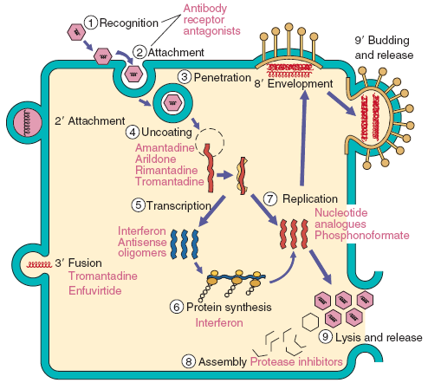
Multiplication of virus
Dr. CHHAY Sokdalis

Slide 2
Objective
After this session the students should be able to:
Define the one-step growth curve of virus.
Describe the effects of virus infection on host cells.
Differentiate persistent viral infections from latent viral infections.
List the Steps in the multiplication of animal viruses in the proper sequence and describe what occurs in each step
Identify the site of viral protein synthesis.
Explain the importance of reverse transcriptase and describe what occurs in the biosynthesis of a virus with reverse transcriptase.
Describe how enveloped ands nonenveloped viruses are released from host cells.
Describe how enveloped viruses obtain their envelopes.

Slide 3
Plan
Introduction
Viral multiplication cycle
Attachment
Penetration
Uncoating
Expression and replication of the viral genome
Assembly
Maturation and release of virus

Slide 4
Introduction
Strict intracellular parasite → Absence of cell division.
Cell acts as factory, providing substrates, energy, and machinery necessary for synthesis of viral proteins and replication of genome.
Specific steps → pharmacological target ideal for antiviral (neuraminidase inhibitor → inhibiting release of influenza virus by Olsetamivir, antiflu).
Knowledge of viral multiplication steps → develop effective pharmacotherapy.

Slide 5
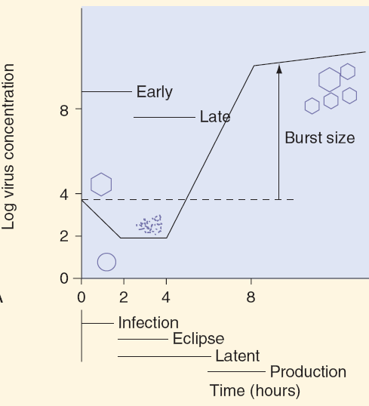
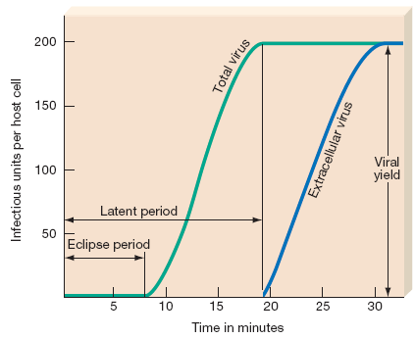
Viral multiplication cycle
2 factors to cells: susceptible and permissiveness
Viral host range: a set of susceptible cells
Infectious for many cells
Infectious specifically for cell type.
Replication curve of virus (one-step growth):
Eclipse period: penetration→ biosynthesis, ends with appearance of new virion after virus assembly.
Latent period: penetration→ release (no extracellular virions can be detected).

Slide 6
Viral multiplication cycle
Viral infection of a cell:
Abortive infection: no progeny virus are produced.
nonpermissive: cells lacked in enzymes, promoters, transcription factors, or other compounds required for complete viral replication.
virus itself has genetically lost ability to replicate.
death of cell, before viral replication has been completed.
Persistent productive infection: virus is released gently from cell through exocytosis or through budding (many enveloped viruses) from plasma membrane.
Latent infection: persistence viral genome inside a host cell with no production of progeny virus (reactivated months or years→ productive infection, integrated into a host cell chromosome→ tumors).
Lytic infection: host cell death and production of progeny virus.

Slide 8
Viral multiplication cycle
Attachment (Adsorption)
Penetration (Entry)
Uncoating
Expression and replication of viral genome (Synthesis)
Assembly (Maturation)
Release of virus

Slide 9
Attachment
Attachment: fixation virus to target cell
Initial attachment → host cell (interaction between specific molecular (spikes) and receptor in host cell membrane (recognize viral structures).
Naked viruses: proteins on surfaces of capsids (VAP) → sites on appropriate host cells.
Enveloped viruses: spikes (glycoprotein) → membrane protein receptor on surface cell.
Some virus receptor → specific for a cell type → specific infection on one cell type:
CD4 T cell → HIV (gp 120).
CD21 B cell → Epstein-Barr virus.
Ubiquitous receptors:
Sialic acid: influenza virus
ICAM1 molecule (Intracellular adhesion molecule): for many human rhinovirus.

Slide 10
Attachment
Attachment: attachment virus to target cell
Viruses of same family → fixing different receptors.
Viruses from different families → fixation same receptor (Coxsackievirus and Adenovirus → attachment same integrin receptor family).
Some viruses: None identified specific receptor.

Slide 11
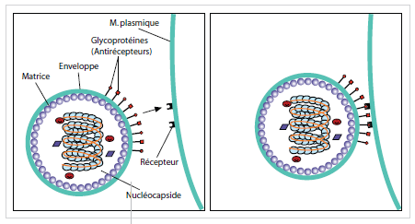
Attachment
Attachment: attachment virus to target cell
Some viruses that receptor expressed on immune cells (co-receptor).
CCR5 HIV → co-receptor for HIV for entry of HIV into macrophage.
Receptor having other functions:
Intercellular adhesin molecule: ICAM1
Lymphositaire surface antigen: CD4
Complements receptor: CD21

Slide 12
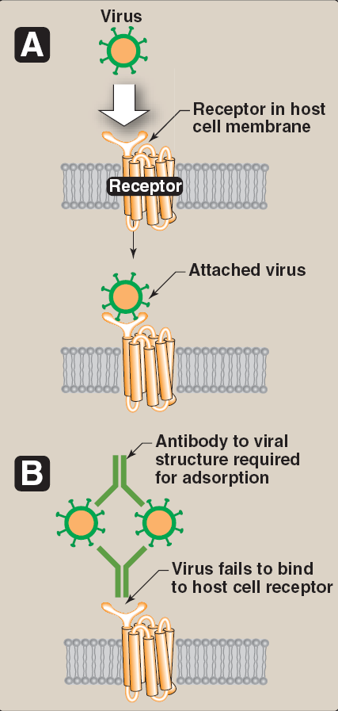
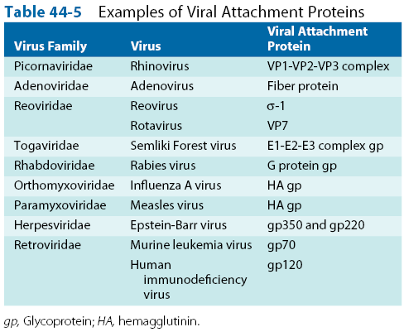
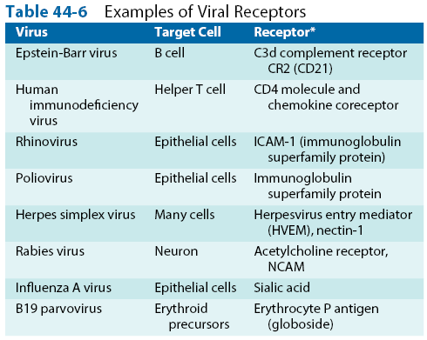
Attachment

Slide 13
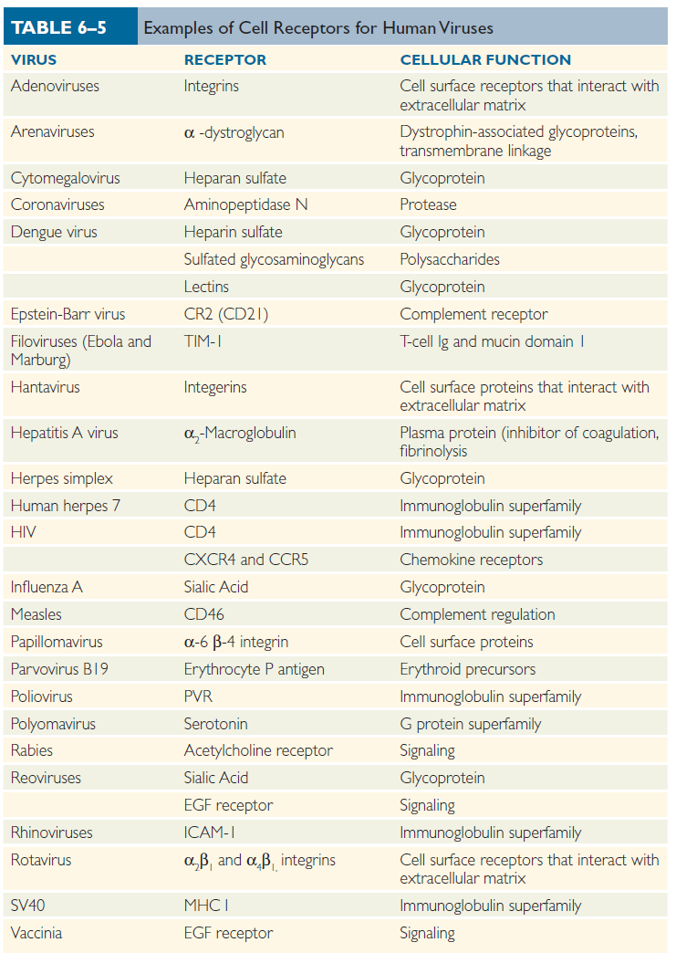

Slide 14
Penetration
Penetration: through cytoplasmic membrane virus → entry into cell → capsid release into cytosol.
Membrane viral fusion and cellular (direct fusion)
Receptor-mediated endocytosis (viropexis)
Transfer of viral material through cell membrane

Slide 15
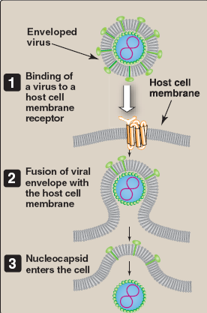
Penetration
Cellular and membrane viral fusion: only in enveloped viruses
Fixing attachment protein on receptor → conformational change → fusion of cell and membrane viral.
Simple fusion: fixation and fusion by viral proteins (Paramyxoviridae).
Complex fusion: several steps involving many proteins (Herpesviridae).

Slide 16
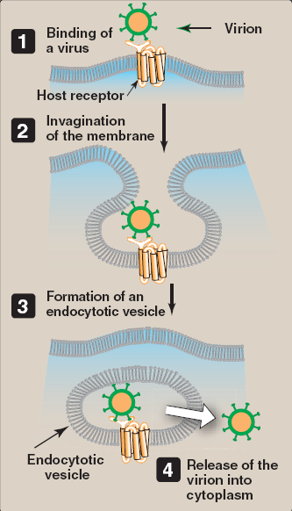
Penetration
2. Receptor-mediated endocytosis:
Enveloped viruses: Orthomyxoviridae, Rhabdoviridae, Arenaviridae, Bornaviridae, Bunyaviridae, Togaviridae and Flaviviridae).
Non-enveloped viruses: Adenovirus and Polyomaviridae.

Slide 17
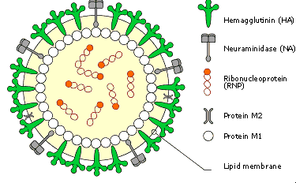
Penetration
2. Receptor-mediated endocytosis
Attachment → internalization of virus
in a cell membrane invagination → vesicle formation→endosome.
Acidification in endosome by proton pump → release nucleocapsid.
Influenza A: M2 protein (proton pump) → lowering pH → exposure of hydrophobic proteins (normally hidden) reacting with membrane lipids of endosome → membrane fusion → release in cytosol nucleocapsid.
Adenovirus: quick release in lower pH → liberation nucleocapsid.
Polyomaviridae: endosome migrant to pore core → nucleocapsid→release.

Slide 18
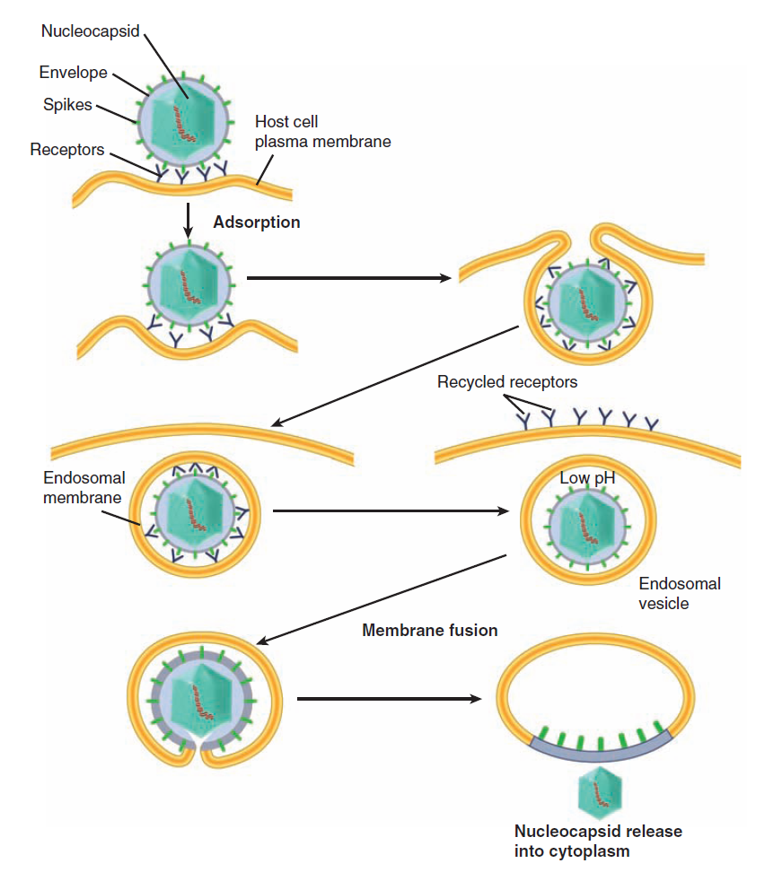

Slide 19
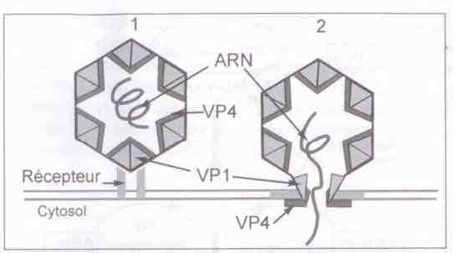
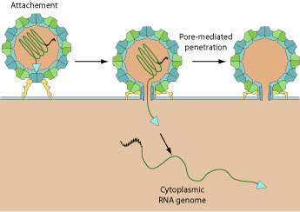
Penetration
3. Transfer of viral material through cell membrane
(Picornaviridae)
No vesicle formation
After attachment of virus VP1 on cell receptor
Changing conformation of VP1 and VP4
Creating a pore for passage of viral RNA
Leading to destabilization of components of virus → uncoating
Transfers of viral genetic material through cell membrane Piconavirivae

Slide 20
Uncoating
Uncoating: viral genome must be separated from its protein coat (released) → transcription and replication (duplicate).
Genome of DNA viruses (except poxviruses)→delivered to nucleus,
Most RNA viruses remain in cytoplasm.
Sometimes early (Picornaviridae): attachment to cell receptor → modification of viral proteins conformation → destabilization of capsid → release of viral RNA.
Influenza A: dissociation of ribonucleic complex (RNP) other proteins (M1 protein) → migration of RNP in nucleus.
Poxviridae: 2 Step
Step 1: Enzyme host, but not complete release.
Step 2: release complete by viral enzyme synthesized after infection.

Slide 21
Expression and replication of viral genome
Most important step in viral replication cycle.
Virus multiplication by duplicating genetic material → replication.
Genetic information of virus resulted in viral protein:
Directly from viral genome (genome serves as mRNA).
Indirectly by intermediate of mRNA (transcription = RNA synthesis).
Precocious proteins or nonstructural or early or factors interfering with cell metabolism.
Protein structures used for construction of new virions.
Viruses hijack machinery of nucleic acid synthesis or protein in infected cells to their advantage, with some inhibition of RNA synthesis and cellular DNA.

Slide 22
Expression and replication of viral genome
DNA Virus
Replication of ds DNA viruses: close to mechanism of cell.
Infectious cycle (multiplication of ds DNA viruses):
Early transcription: synthesis of nonstructural precocious protein → replication, transcription of genetic material and regulation of gene expression.
Late transcription: synthesis of new genetic material →structural proteins → viral particle constituents.
dsDNA viruses: Poxviridae, Papillomaviridae, Poliomaviridae and Adenoviridae → infectious cycle → 2.
Herpesvirus → infectious cycle → 3 (immediate-early, early and late).
Replication of ssDNA virus (Parvoviridae): completely dependent on host machinery (replicates viral DNA together with cellular DNA).

Slide 23
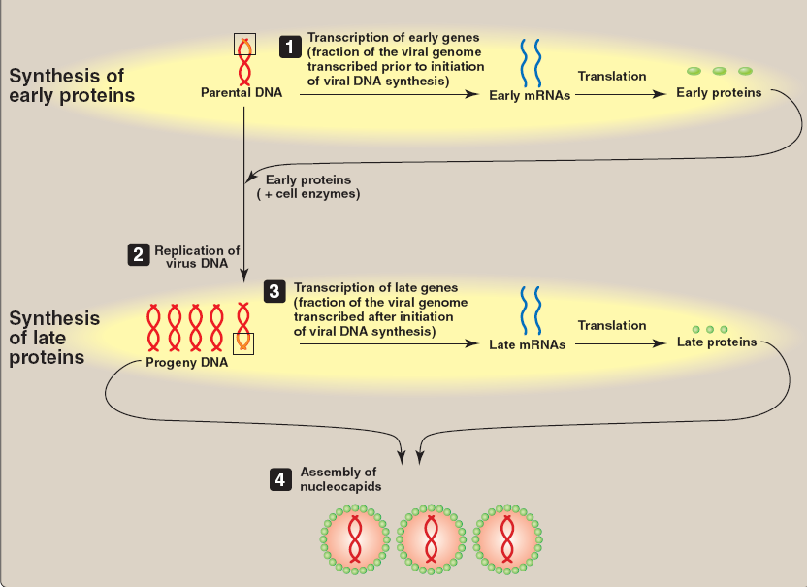

Slide 25
Expression and replication of viral genome
Replication
Replication of RNA viruses: segmented or not, double-stranded or single-stranded, positive or negative polarity.
Replication (synthesis of genomic RNA or mRNA): needs intervention RNA dependent -RNA polymerase.
All RNA viruses (except Retroviruses) with gene coding for this enzyme.
Replication mechanism varied depending on nature of genomic RNA:
RNA viruses (+) mRNA identical form → direct protein synthesis.
RNA virus (-) or double-stranded → transcription previously → mRNA.

Slide 26
Expression and replication of viral genome
Principal elements of synthesis of viral RNA:
Enzyme
RNA-dependent RNA polymerase: replication (synthesis of viral genomic RNA and transcription (mRNA).
Viral enzyme accessory: manage and facilitating RNA polymerase.
Protein of cellular origin may be associated with transcription and replication (eg. certain cytoskeletal proteins binding to certain patterns of RNA, poly (rC) binding protein).
RNA template: viral RNA genome (-), (+).
Primer: Most RNA-dependent RNA polymerase → RNA synthesis without a primer.

Slide 27
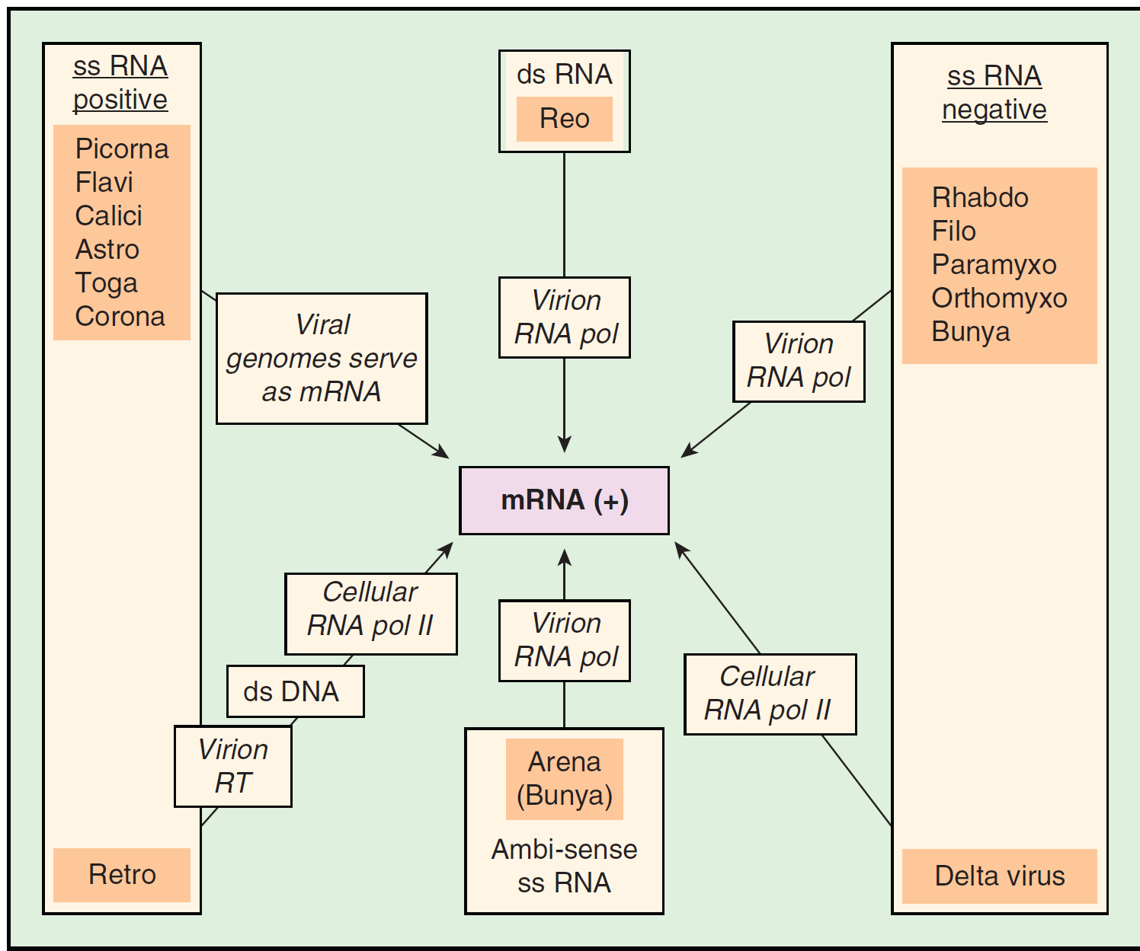

Slide 30
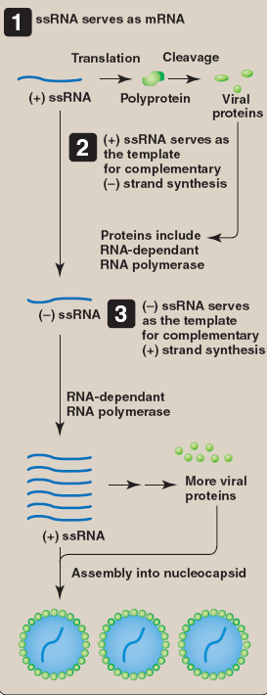
Expression and replication of viral genome
Single-stranded RNA viruses (+) : Astroviridae, Calciviridae, Coronaviridae, Flaviviridae, Picornaviridae and Togaviridae
As mRNA: Viral genome → translation directly → a single polyprotein → maturation viral protease→structural and non-structural proteins.
As template for complementary (–) strand synthesis: virus-encoded RNA-dependent RNA polymerase to synthesize complementary (–) ssRNA (progeny (–) strands, in turn, serve as templates for synthesis of progeny (+) strands).
Viral genome is infectious

Slide 32
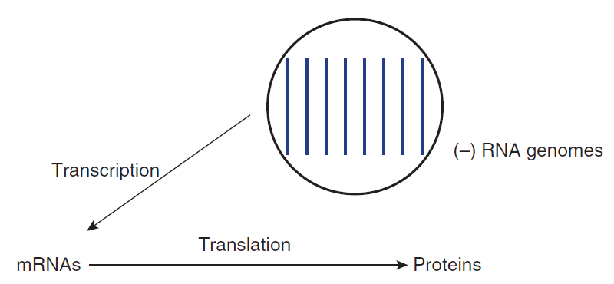
Expression and replication of viral genome
Single-stranded RNA virus (-) segmented Orthomyxoviridae, Bunyaviridae
Each segment transcribed→mRNA → protein → by proteolytic cleavage.
Complex RNA polymerase (PA (initializing replication), PB1 (elongation) and PB2 (initialization of transcription)).
Viral transcription:
Primer from 5‘ end of cellular mRNA.
Elongation →addition polyA sequence at 3‘ mRNA.
Replication: RNA polymerase working on synthesis of RNA (+) and (-) without primer.

Slide 33
Expression and replication of viral genome
Single-stranded RNA viruses (-) non-segmented: Bornaviridae, Filoviridae, Paramyxoviridae and Rhabdoviridae
Genome consisting of genes separated by intergenic sequences (polyadenylation signal→termination and initiation of transcription of this gene).
Transcription: polymerase associated with 3‘ →5‘.
Only a fraction of RNA polymerase crosses intergenic region → reduced amount of mRNA from 3‘ to 5‘.
Replication: nucleoprotein binding to RNA (+) → allowing RNA polymerase to copy intergenic junction without stops.
Viral genome of negative polarity is noninfectious Infection requires a virion-associated RNA polymerase

Slide 34
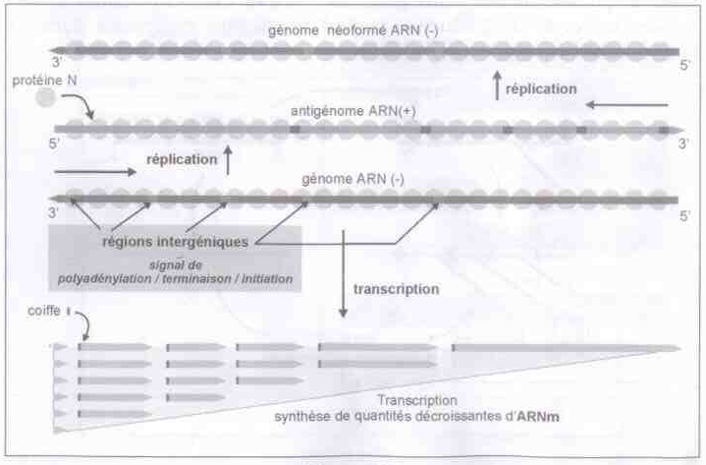
Expression and replication of viral genome
Multiplication scheme RNA viruses (-) unsegmented

Slide 35
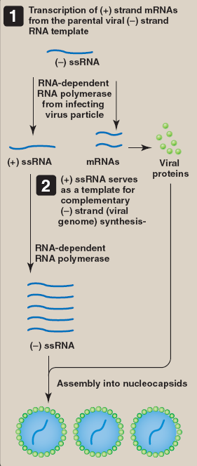
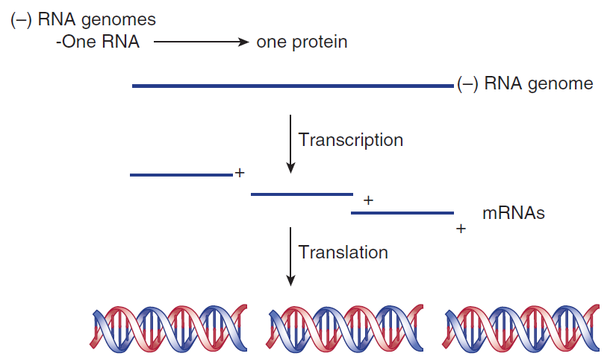

Slide 36
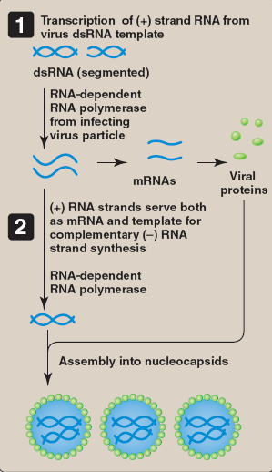
Expression and replication of viral genome
Double-stranded RNA viruses or double-stranded segmented: Reoviridae
Transcription mRNA by virion-associated RNA polymerase.
mRNA → Leaving viral particle in cytoplasm → protein synthesis.
(+) RNA → packaged and copied for synthesis of a new double-stranded RNA genome.

Slide 37
Expression and replication of viral genome
Virus using reverse transcriptase (RT = reverse transcriptase)
HIV (Retroviridae) and Hepadnaviridae Hepatitis B
DNA synthesis from (+) RNA genome for Hepadnaviridae or replication product for Hepadnaviridae intervention by reverse transcriptase.
Reverse transcriptase with 2 functions:
DNA polymerase (RNA-dependent)
RNase H activity: degradation of RNA hybridized to DNA formed (RNA-DNA Double helices)
Reverse transcriptase (RT) is a pharmacological target of antiretroviral used in treatment of HIV

Slide 38
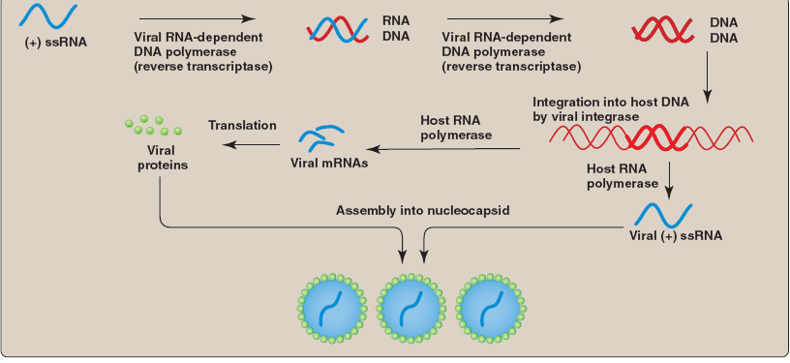
Expression and replication of viral genome

Slide 40
Assembly, Maturation and release of virus
Assembling structural protein.
Incorporation of viral genome into procapsid.
Maturation of viral protein by proteolytic cleavage or conformational change.
Mechanism can be simple → self-assembly .
Complex mechanism requiring intervention of specific viral protein (chaperone or scaffolding "scaffolding protein") for assembly or structural proteins of viral genome encapsidation.

Slide 41
Assembly, Maturation and release of virus
Virion release by budding:
plasma membrane
nuclear membrane
endoplasmic reticulum membrane.
Release of non-enveloped virus → cell lysis.

Slide 42
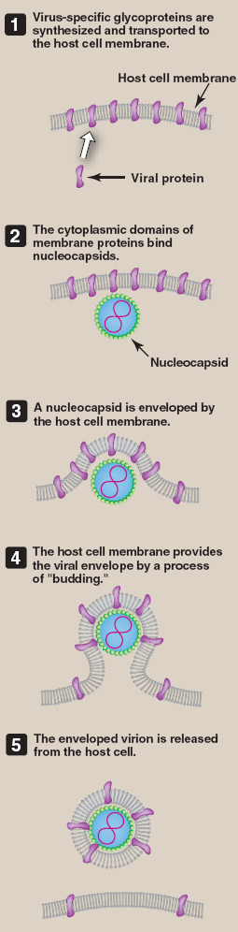

Slide 43
References
Richard Goering, Hazel Dockrell, Mark Zuckerman, Peter Chiodini. Mims Medical Microbiology and Immunology. Elsevier. 2019.
JACQUELYN G. BLACK. MICROBIOLOGY 7e PRINCIPLES AND EXPLORATIONS. 2008.
Patrick R. Murray, Ken S. Rosenthal, Michael A. Pfaller. MEDICAL MICROBIOLOGY. 2013. 7th EDITION.
BRIAN W J MAHY, MARC H V VAN REGENMORTEL. Desk Encyclopedia of GENERAL VIROLOGY. 2010.
Cynthia Nau Cornelissen, Bruce D. Fisher, Richard A. Harvey, Lippincott’s Illustrated Reviews: Microbiology. Third Edition. 2013.
Kenneth J. Ryan, MD, C. George Ray. Sherris Medical Microbiology. 6th edition. 2014.
Jeffrey C. Pommerville. Alcamo’s FUNDAMENTALS OF Microbiology. 9th edition. 2011.

Slide 44
Assignment
Multiplication (replication) cycle of:
Smallpox virus
Human papillomavirus
Rotavirus
Adenovirus
Human immunodeficiency virus
Coronavirus
Rhabdovirus

